Slide 1
Statistical fundamentals to characterize data

Slide 2
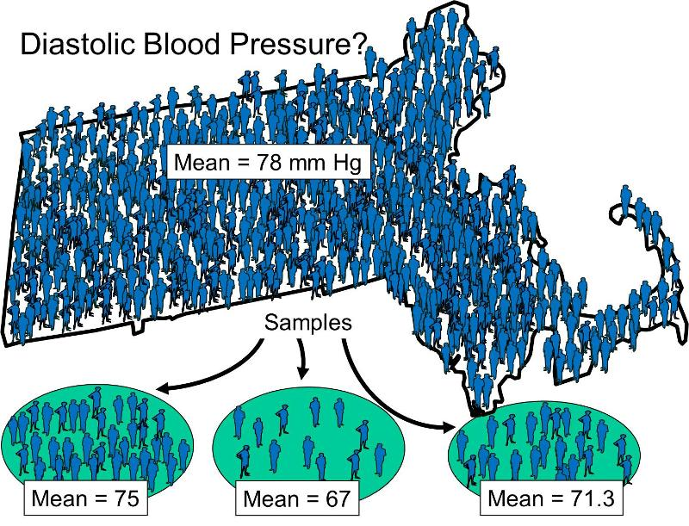
Terminology Populations & Samples
Population: the complete set of data (individuals, objects, scores…)
Often too large to sample in its entirety
Sample: A subset of the population.
A sample may be classified as random (each member has equal chance of being selected from a population) or convenience (what’s available).
Random selection attempts to ensure the sample is representative of the population.

Slide 3
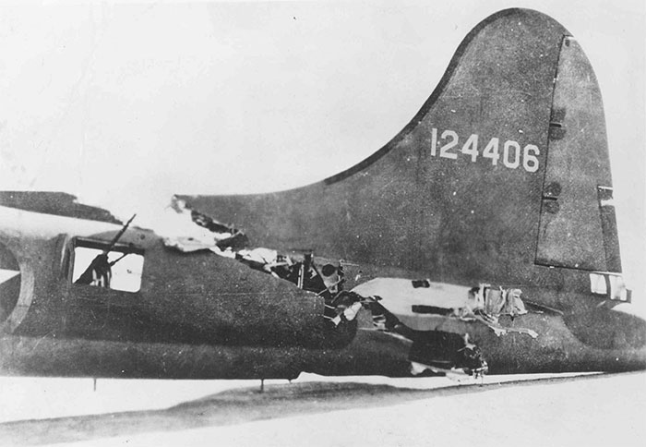
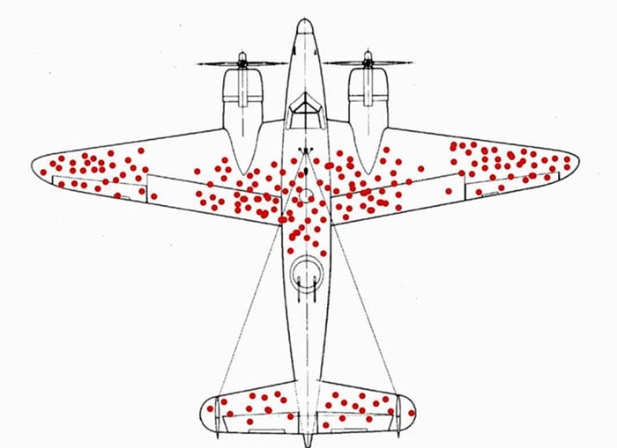
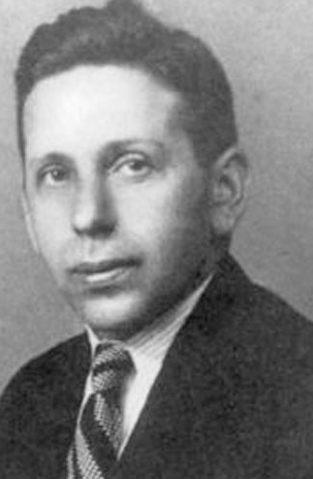
Statistical Inference
Statistical Inference – the process of drawing conclusions about a population based on information in a sample
Whether or not a sample is representative of a population depends on (i) how individuals in sample are chosen and (ii) what is being measured.
Non-random sampling can lead to Sampling Bias, i.e., tendency for some individuals to be selected more readily that others. A different type of non-randomness is selection of individuals such that the variation among individuals in the sample is not representative of the underlying variability in the population, i.e. the sample is too homogenous.
Notes:
Abraham Wald and Survival bias

Slide 4
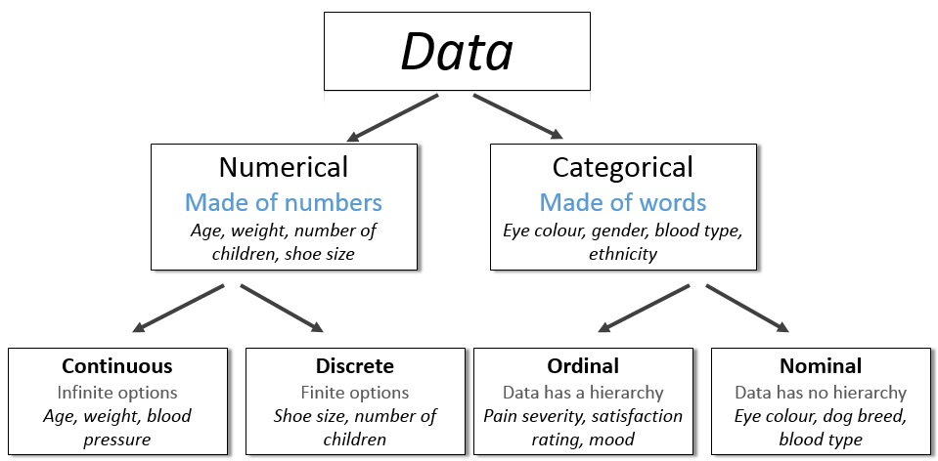
Data Variables
Variables are the quantities measured in a data sample
They may be classified as:
Data Variables
Notes:
Numerical variables are also known as quantitative

Slide 5
Frequency Distributions
Serum CK (U/I) | Frequency | Relative Frequency | Cumulative Rel. Frequency
20-39 | 1 | 0.028 | 0.028
40-59 | 4 | 0.111 | 0.139
60-79 | 7 | 0.194 | 0.333
80-99 | 8 | 0.222 | 0.555
100-119 | 8 | 0.222 | 0.777
120-139 | 3 | 0.083 | 0.860
140-159 | 2 | 0.056 | 0.916
160-179 | 1 | 0.028 | 0.944
180-199 | 0 | 0.000 | 0.944
200-219 | 2 | 0.056 | 1.000
Total | 36 | 1.000
An (Empirical) Frequency Distribution or Histogram for a continuous variable presents the counts of observations grouped within pre-specified classes or groups
Example: Blood samples taken from 36 male volunteers as part of a study to determine the natural variation in serum CK concentration.
121 | 82 | 100 | 151 | 68 | 58
95 | 145 | 64 | 201 | 101 | 163
84 | 57 | 139 | 60 | 78 | 94
119 | 104 | 110 | 113 | 118 | 203
62 | 83 | 67 | 93 | 92 | 110
25 | 123 | 70 | 48 | 95 | 42
Notes:
A Barchart presents the frequencies for a categorical variable

Slide 6
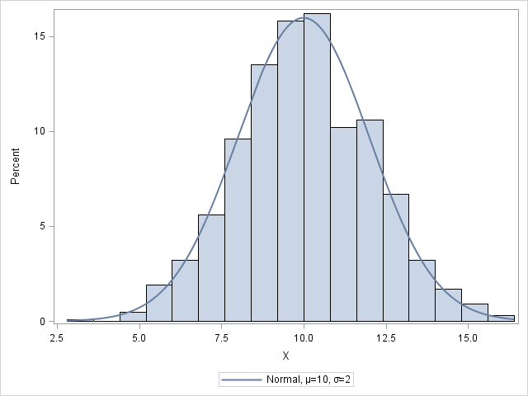
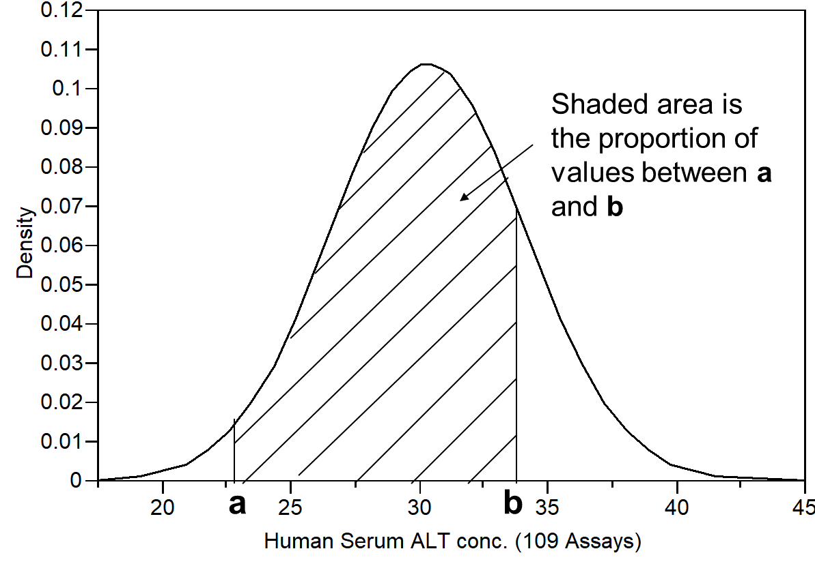
Density curve
As sample size increases, histogram class widths can be narrowed such that the histogram eventually becomes a smooth curve
The population histogram of a random variable is referred to as the distribution of the random variable, i.e. it shows how the population is distributed across the number line
A smooth curve representing a relative frequency distribution is called a density curve
The area under the density curve between any two points a and b is the proportion of values between a and b.

Slide 7
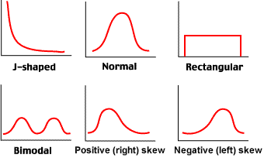
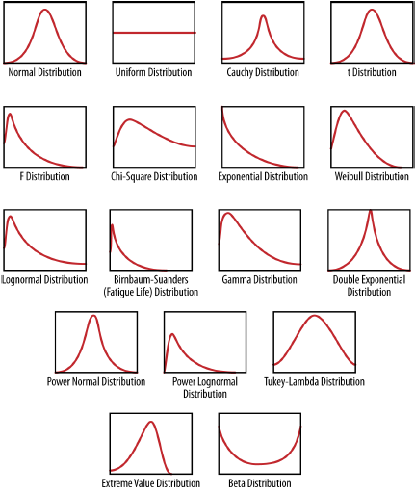
Distribution Shapes

Slide 8
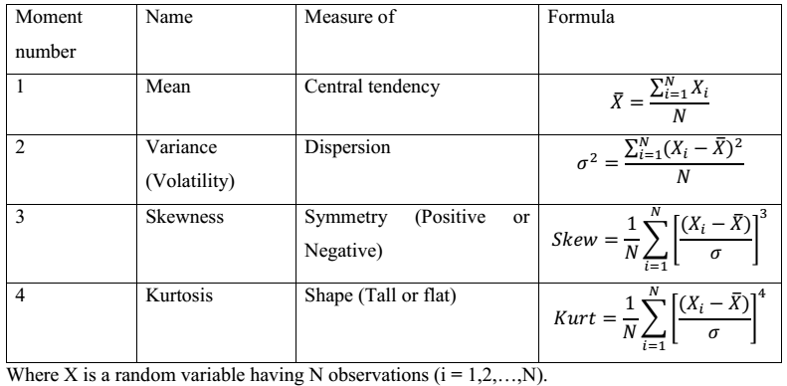
How can you characterize the distribution of your data?

Slide 9
1. Measures of Central Tendency (Location) in data
Measures of location indicate where on the number line the data are to be found.
Common measures of location are:
(i) the Arithmetic Mean,
(ii) the Median, and
(iii) the Mode

Slide 10
The Mean
Let x₁,x₂,x₃,…,x_{n} be the realised values of a random variable X, from a sample of size n. The sample arithmetic mean is defined as:
Example: The systolic blood pressure of 7 middle aged men were:
151, 124, 132, 170, 146, 124 and 113.

Slide 11
The Median and Mode
If the sample data are arranged in increasing order, the median is
the middle value if n is an odd number, or
midway between the two middle values if n is an even number
The mode is the most commonly occurring value.
The reordered systolic blood pressure data seen earlier 151, 124, 132, 170, 146, 124 and 113 are:
113, 124, 124, 132, 146, 151, 170
The Median is the value in the middle of the ordered data: 132
Two individuals have systolic blood pressure = 124 mm Hg, so the Mode is 124.

Slide 12
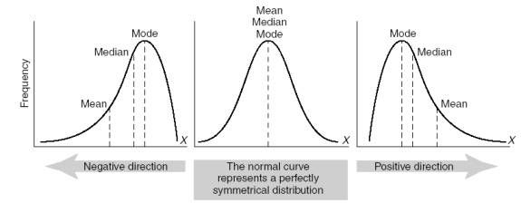
Mean versus Median
Large sample values tend to inflate the mean. This will happen if the histogram of the data is right-skewed.
The median is not influenced by large sample values and is a better measure of centrality if the distribution is skewed.
Note if mean=median=mode then the data are said to be symmetrical

Slide 13
2. Measures of Dispersion
Measures of dispersion characterise how spread out the distribution is, i.e., how variable the data are.
Commonly used measures of dispersion include:
Range (difference between the largest and smallest observations in the sample)
Variance & Standard deviation

Slide 14
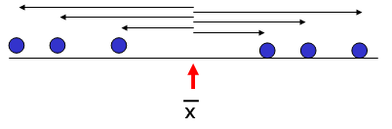
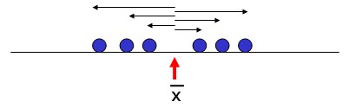
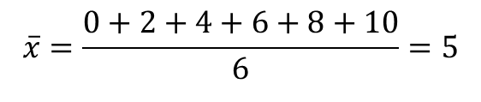
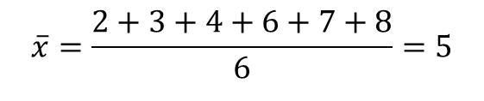
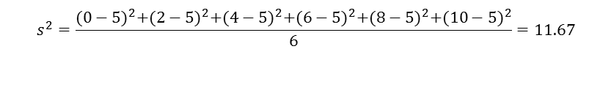
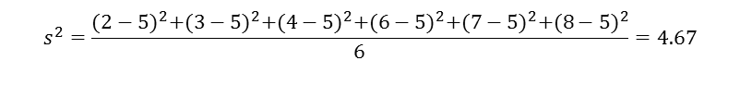
Sample Variance
The sample variance, s², is the arithmetic mean of the squared deviations from the sample mean:
>
[0,2,4,6,8,10]
[2,3,4,6,7,8]
Notes:
Why divide by n-1 in the formula for the sample standard deviation ?
The rationale for this arises from the fact that the sum of deviations sum to 0. Therefore, once the first n-1 deviations have been calculated, the last deviation is constrained, Therefore, in a sample of size n, there are only n-1 pieces of information concerning deviation from the average. The quantity n-1 is called the degrees of freedom of the sample standard deviation.
In practice, if n is large, regardless of whether one divides by n or n-1 doesn’t make much difference to the calculation of the sample standard deviation.

Slide 15
Standard Deviation
The sample standard deviation, s, is the square-root of the variance
s has the advantage of being in the same units as the original variable x

Slide 16
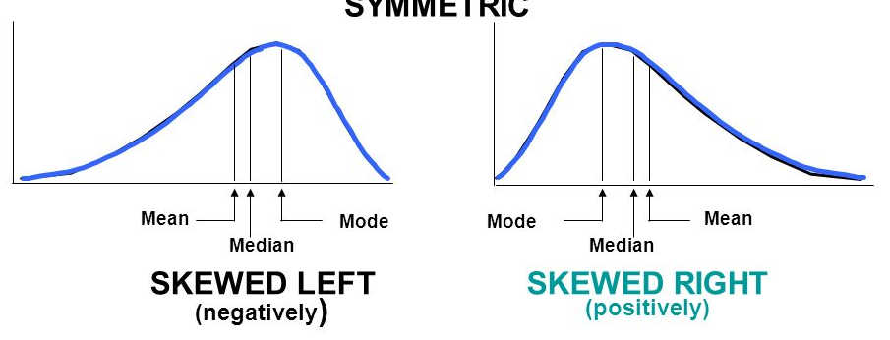
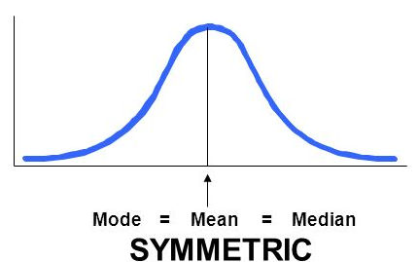
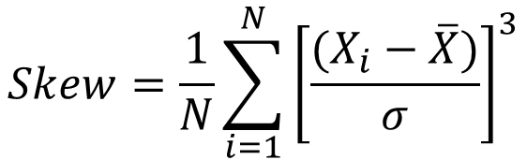
3. Skewness
The coefficient of the skewness is a measure of the degree of symmetry in the variable distribution
$$Skew=\frac{1}{N}\sum_{i=1}^{N}{{\left[\frac{(X_{i}−\overline{X})}{σ}\right]}^{3}}$$
Skewness < 0
Skewness = 0
Skewness > 0

Slide 17
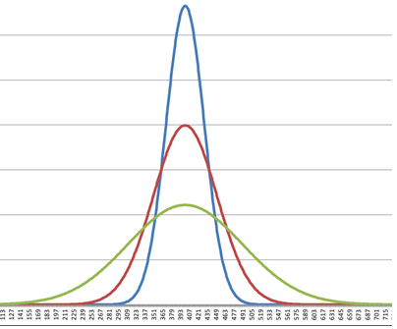
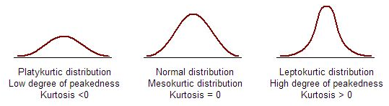
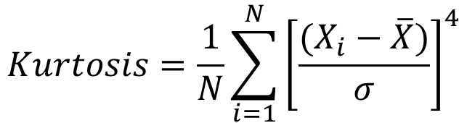
4. Kurtosis
The coefficient of kurtosis is a measure for the degree of peakedness/flatness in the variable distribution
$$Kurtosis=\frac{1}{N}\sum_{i=1}^{N}{{\left[\frac{(X_{i}−\overline{X})}{σ}\right]}^{4}}$$

Slide 18
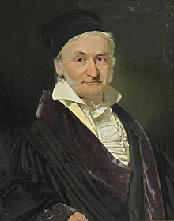
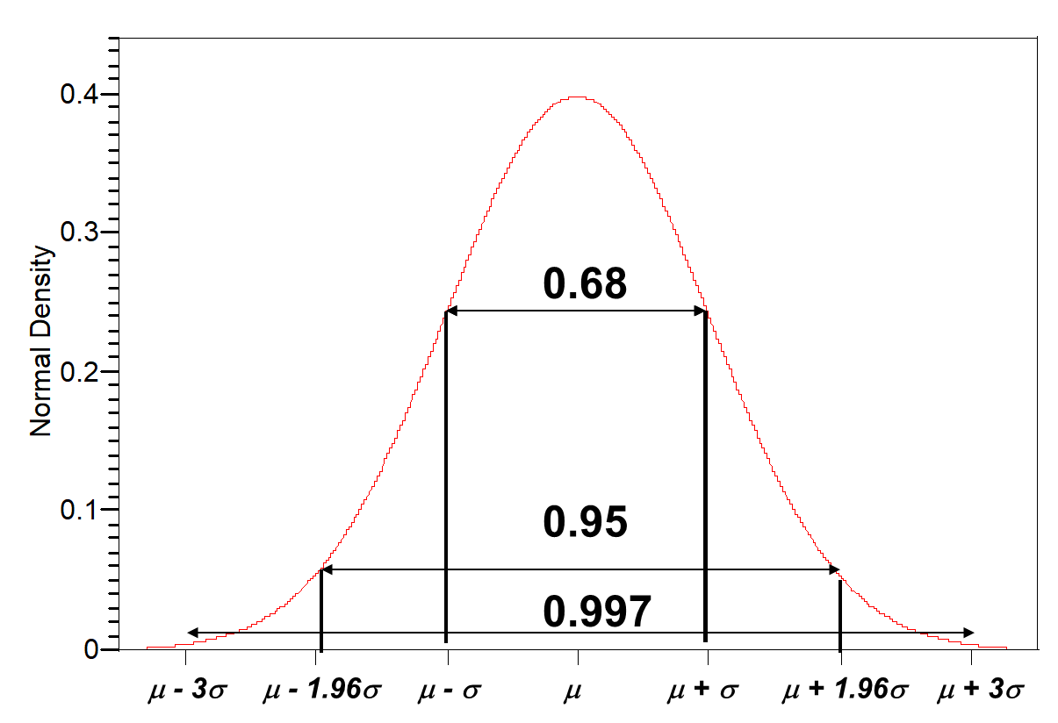
The Normal/Gaussian Distribution
The Normal distribution is considered to be the most important distribution in statistics
Two parameters define a Gaussian:
Mean μ - location of center
Variance σ² - spread/width of curve
It occurs in “nature” from processes consisting of a very large number of elements acting in an additive manner
The Normal distribution has a symmetric bell-shaped density curve
Characterised by two parameters, i.e. the mean μ, and standard deviation σ
68% of data lie within 1σ of the mean μ
95% of data lie within 2σ of the mean μ
99.7% of data lie within 3σ of the mean μ

Slide 19
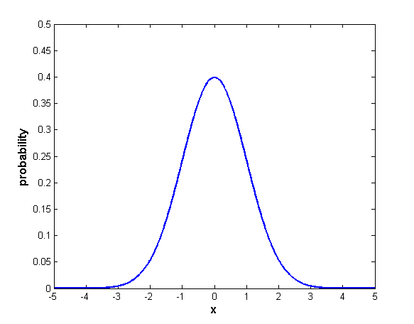
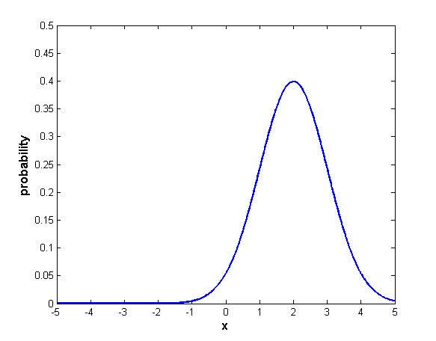
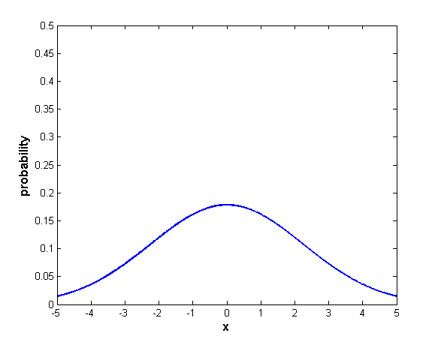
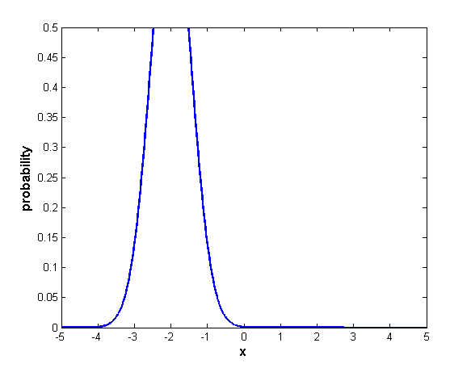
Gaussian distribution
μ = 0 σ² = 1
μ = 2 σ² = 1
μ = 0 σ² = 5
μ = -2 σ² = 0.3

Slide 20
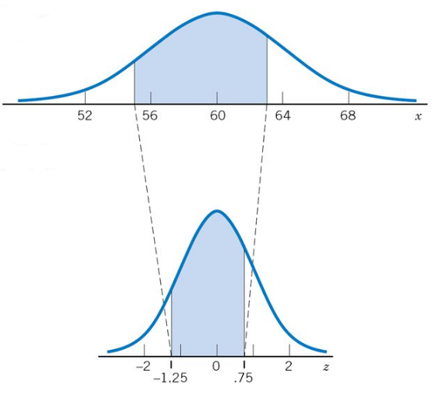









Converting any normal probability distribution to a standard normal probability distribution
$$X$$
If X is a Normally distributed random variable with mean = μ and standard deviation = σ, then X can be converted to a Standard Normal random variable Z using:
Z has mean = 0 and standard deviation = 1
Using this transformation, we can easily calculate areas under any normal distribution
$$μ_{1}$$
$$μ_{2}$$
$$μ_{3}$$
$$μ_{4}$$
$$σ_{1}$$
$$σ_{2}$$
$$σ_{3}$$
$$σ_{4}$$

Slide 21
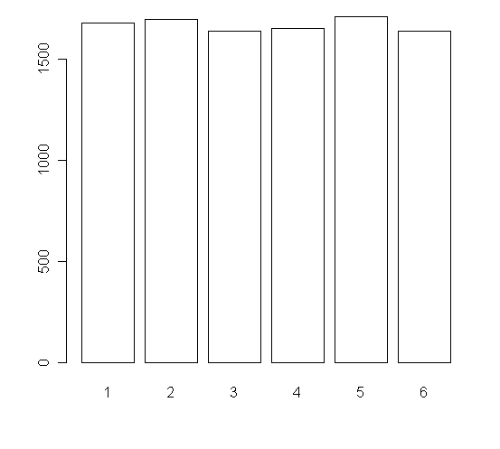
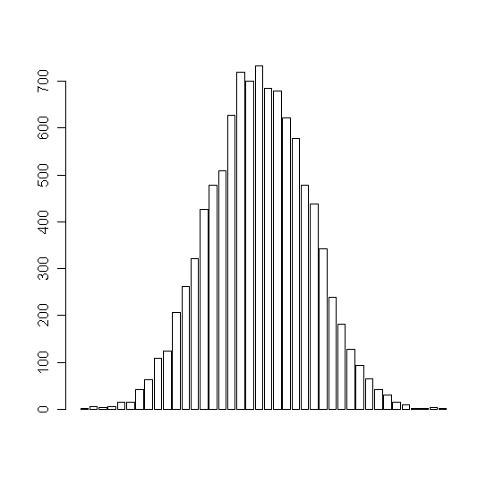
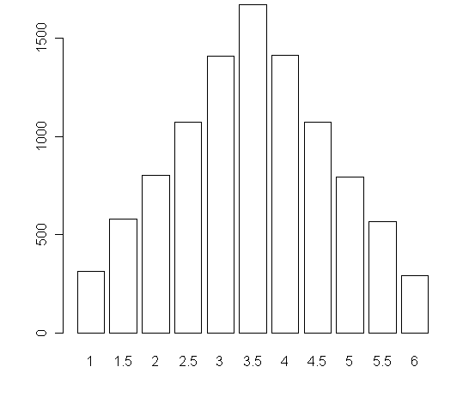
Central Limit Theorem (CLT) Example: Toss 1, 2 or 10 dice (10,000 times)
Toss 1 dice
Histogram of
data
Toss 2 dice
Histogram of averages
Toss 10 dice
Histogram of averages
Distribution of data
is far from Normal
Distribution of averages approach Normal as sample size (no. of dice) increases
Notes:
Suppose you take any random sample from a population with mean μ and variance σ² following any type of distribution
Then, for large sample sizes, the CLT states that the distribution of sample means is the Normal Distribution, with mean μ and variance σ²/n (i.e. standard deviation is σ/√n )
It doesn’t matter what the distribution of the original data is, the sample mean will always be Normally distributed when n is large.
If the original data is Normal then the sample means are Normal, irrespective of sample size

Slide 22
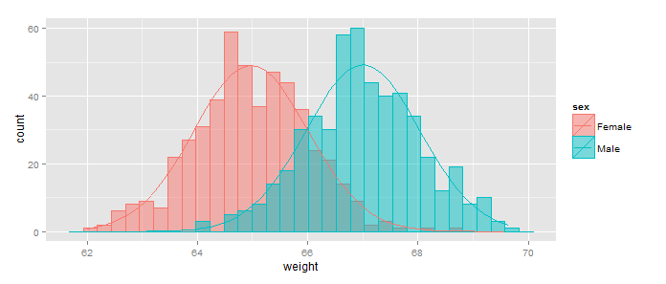
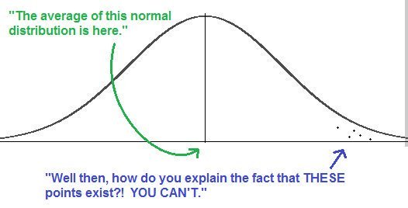
The importance of thinking in terms of probability clouds instead of binary categories
Trait

Slide 23
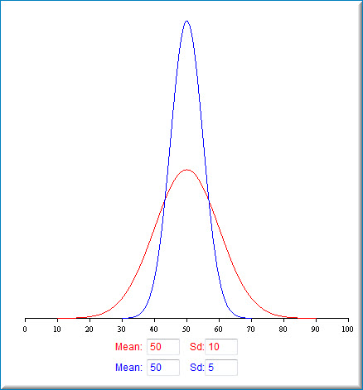
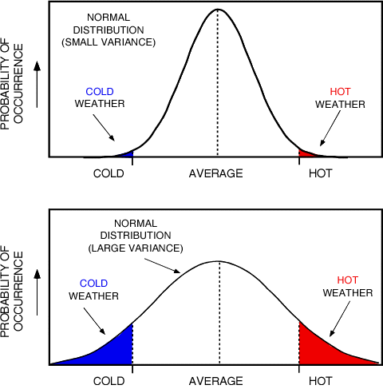
Normal curves with the same mean but different standard deviations
Two cities have the same yearly average temperature: could one of them have substantially more hot days in any given year than the other?

Slide 24
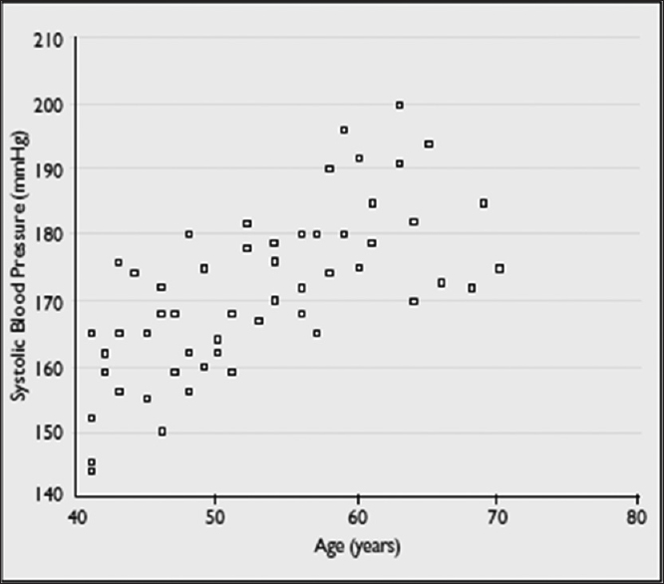

Scatter-plot
Age
Income
Weight
Blood pressure
$$X$$
Displays the relationship between two continuous variables
Useful in the early stage of analysis when exploring data and determining is a linear regression analysis is appropriate
May show outliers in your data

Slide 25
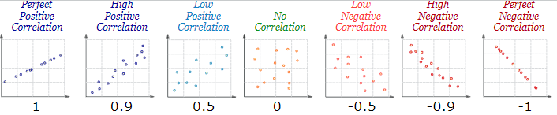
Correlation
Sometimes we have two quantitative measurements which are related in some way
Correlation: The degree of relationship between the variables under consideration is measure through the correlation analysis.
The measure of correlation called the correlation coefficient
The degree of relationship is expressed by coefficient which range from correlation ( -1 ≤ r ≥ +1)
The direction of change is indicated by a sign.
The correlation analysis enable us to have an idea about the degree & direction of the relationship between the two variables under study.

Slide 26
Causal Explanation
Causal effect: The finding that change in one variable leads to change in another variable, other things being equal.
Criteria for Identifying a Causal Effect
1. Association: Empirical (observed) correlation between independent and dependent variables (must vary together)
2. Time Order: Independent variable comes before dependent variable
3. Nonspuriousness: Relationship between independent and dependent variable not due to third variable
Example: ‘‘The correlation between workers’ education grades and wages is strongly positive”

Slide 27
Correlation vs. Causation
Possibility 1
Studying hard improves skills & skilled workers get better paying jobs
Education causes wages to ↑
Possibility 2
Individuals are born with quality A, which is relevant for success in education AND on the job
Quality A (NOT education) causes wages to ↑

Slide 28
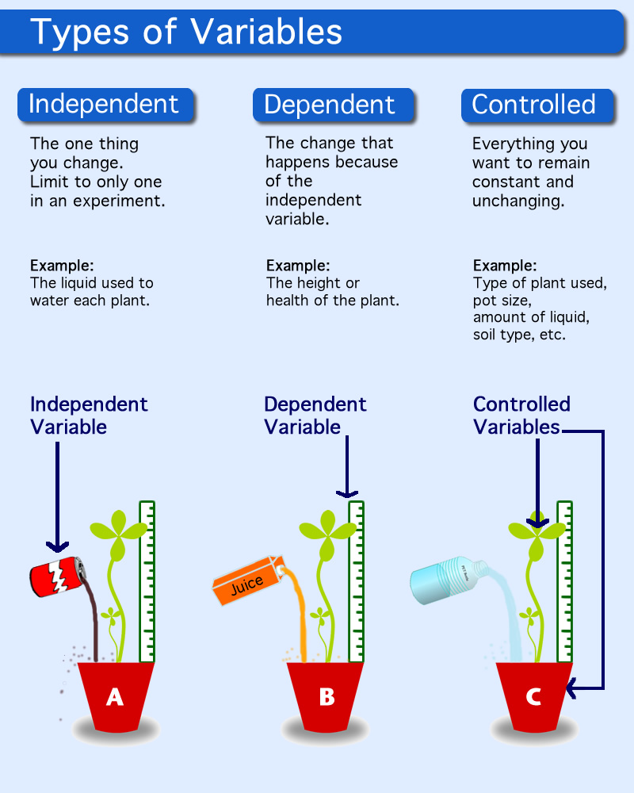
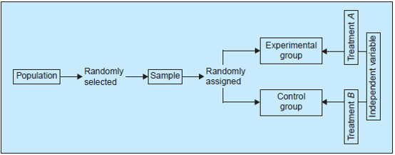
Establishing causality
The only way of establishing causality is through a controlled experiment involving:
Dependent/Response. Variable of primary interest (e.g. blood pressure in an antihypertensive drug trial). Not controlled by an experimenter.
Independent/Predictor
called a Factor when controlled by experimenter. It is often nominal (e.g. treatment)

Slide 29
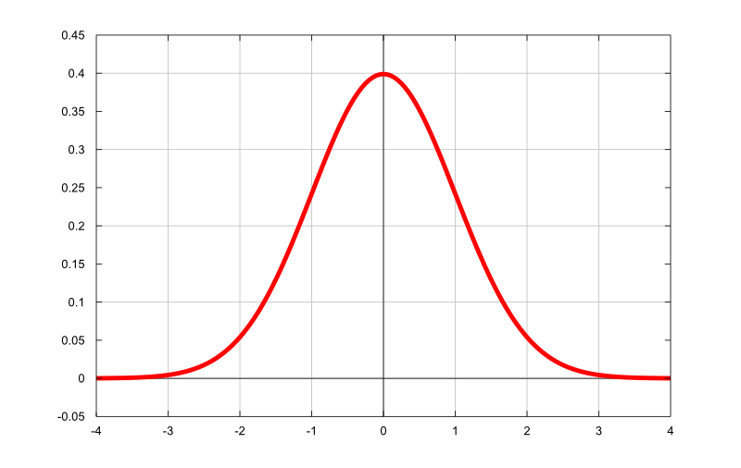
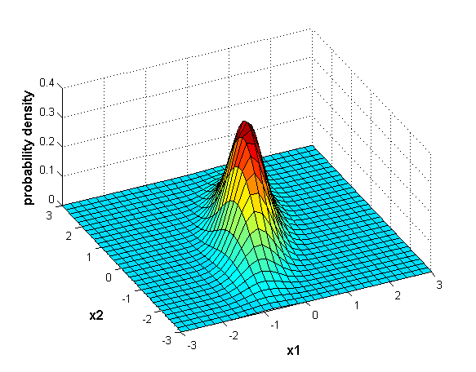

Multivariate Gaussian distribution
Just two dimensions
$$X$$

